Slide 1
SAS External PowerPoint
SAS Corporate
Updated August 2025

Slide 2
HOW TO SAVE AS A PDF
Please follow these guidelines when saving as a PDF to retain the Anova font.
The Anova font isn’t part of the Adobe family of fonts; therefore, saving slideware as a PDF requires a specific approach. Follow the quick steps below to produce a PDF for your deck. It’s important to note, the document will not automatically open after saving. DO NOT use Save as Adobe PDF or right-click on a PowerPoint file in the directory and select any of the Convert, Create, or Combine Adobe options.
Saving to the same location as the PowerPoint deck:
On a PC
Saving to a different location than the PowerPoint deck:
On a PC
1. | Select File.
2. | Select Save As (or Save a Copy).
3. | Select the drop-down arrow below the File Name, then select the PDF (*.pdf) option.
4. | Select the Save button.
1. | Select File.
2. | Select Save As (or Save a Copy) and then select Browse.
3. | Locate the preferred Folder.
4. | Select the drop-down arrow next to Save as type, then the PDF (*.pdf) option.
5. | Select the Save button.
On a Mac
On a Mac
1. | Select File.
2. | Select Save As (or Save a Copy).
3. | Select the drop-down arrow next to File Format, then select the PDF (*.pdf) option. (see Note below)
4. | Select the Save button.
1. | Select File.
2. | Select Save As (or Save a Copy) and then browse the Sidebar to locate the folder..
4. | Select the preferred Folder.
5. | Select the drop-down arrow next to File Format, then the PDF (*.pdf) option. (see Note below)
6. | Select the Save button.
Go here for additional information and screenshots.
*NOTE: When asked if you want Best for electronic distribution and accessibility or Best for printing, select Best for printing. This WILL NOT retain hyperlinks.

Slide 3
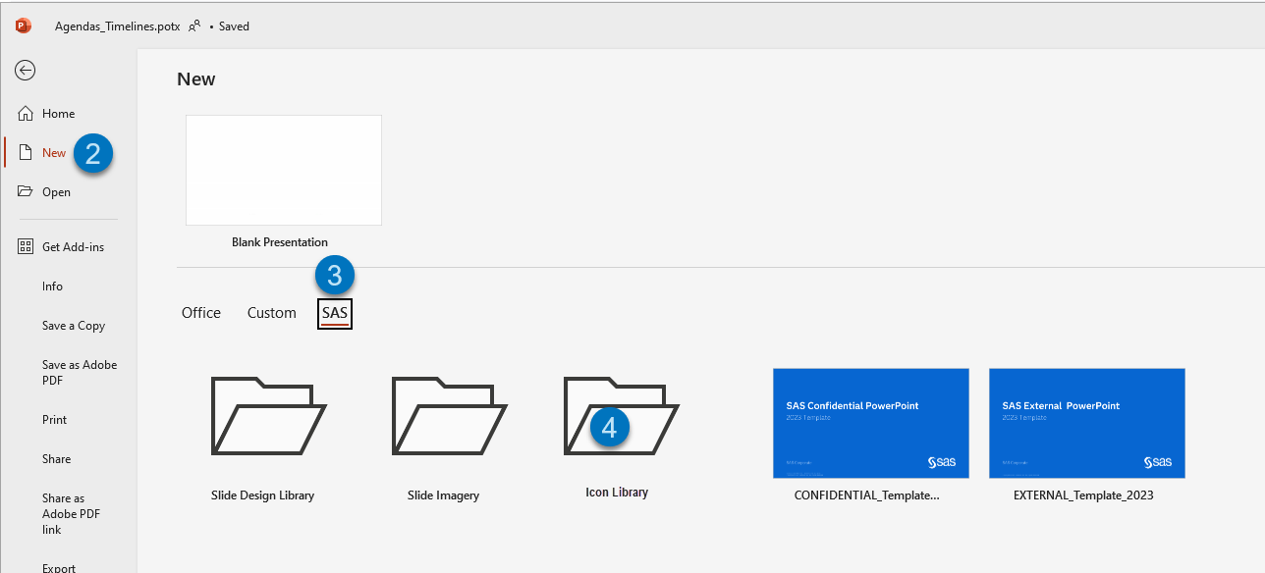
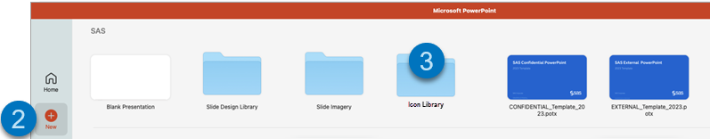
HOW TO LOCATE ICONS
Please follow these steps to locate the icons using the PowerPoint desktop app.
On a PC On a Mac
1. | Select File.
2. | Select New.
3. | Select the SAS folder.
4. | Select the Icon Library folder and launch the file.
5. | Copy your icon and paste it into your slide.
1. | Select File.
2. | Select New from Template...
3. | From the SAS options, select the Icon Library folder and launch the file.
4. | Copy your icon and paste it into your slide.

Slide 4



HOW TO USE ICONS
Please follow these guidelines when utilizing icons in your presentation.
ONLY USE THESE SPECIFIED COLORS.
DO NOT MODIFY, COMBINE OR CREATE NEW ICONS.
USE ICONS SPARINGLY AND WITH INTENTION.
DO NOT make icons the primary visual element. Size icons conservatively.
DO NOT
combine icons.
DO NOT
modify icons.
DO NOT
create new icons.
Slate on white backgrounds.
SAS Blue icons may be used on white backgrounds to highlight content, but only within web environments, such as for rollover states.
White on SAS Blue or dark backgrounds.
DO NOT use icons
as a substitute for bullet points.
DO NOT MODIFY LINE WEIGHT OR STYLING.
USE icons to reinforce the high-level subject, not elements or points within the copy.
DO NOT
modify line weight.
DO NOT
add effects.
DO NOT
add solid fills.

Slide 5







HOW TO USE SAS COLORS
Please follow these guidelines when utilizing the color palette in your presentation.
Need help incorporating the new shades?
To convert slides from the old PPT template, which included multiple colors and a dark background, follow this guide to swap the previous shades for the NEW Light and bright ones.
If your slides don’t auto-convert to the new shades, here are the recommended options.
SAS BLUE
We highly recommend using the SAS BLUE
first.
BEFORE
AFTER
TOPIC
Add content here.
TOPIC
Add content here.
TOPIC
Add content here.
TOPIC
Add content here.
TOPIC
Add content here.
TOPIC
Add content here.
TOPIC
Add content here.
TOPIC
Add content here.
TOPIC
Add content here.
TOPIC
Add content here.
Start with the SAS blue when selecting a shape color.
The first four in the color
palette are used for text.
The final six in the color palette are used for shapes.
*This was the previous corporate PPT theme used prior to Sept 2023. It should no longer be used.

